Slide 1
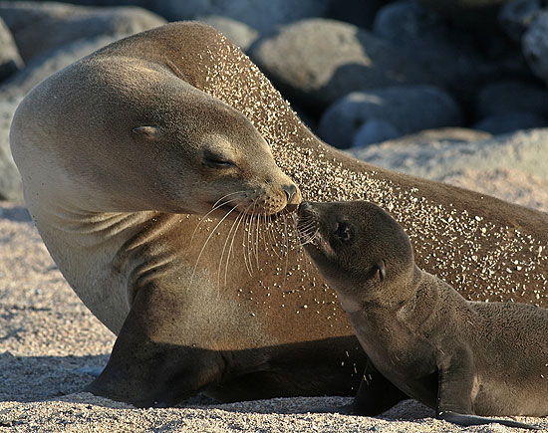
15.1Darwin’s Theory of Evolution by Natural Selection
Continued

Slide 2
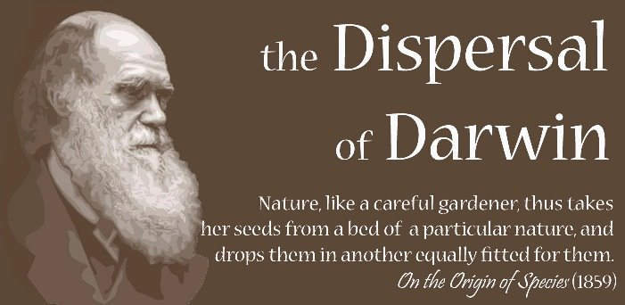
15.1Darwin’s Theory of Evolution by Natural Selection

Slide 3
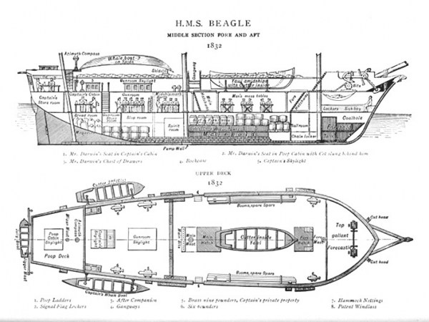
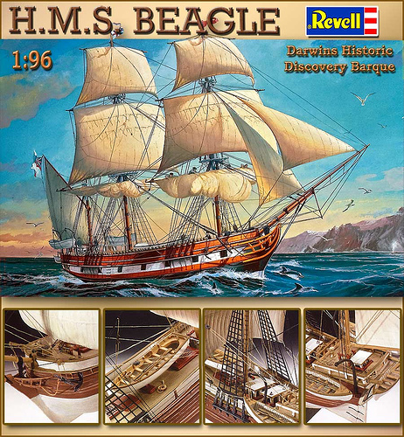
Darwin’s Return

Slide 4
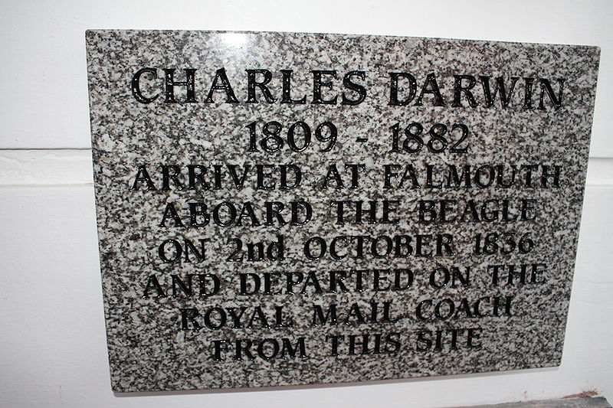
Darwin’s Return
Darwin returned to England in 1836 and brought the specimens he had collected from around the world.

Slide 5
Darwin’s Return
He made some remarkable discoveries about some species – most notably- finches

Slide 6
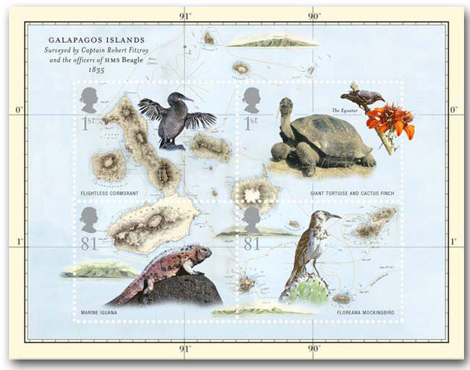
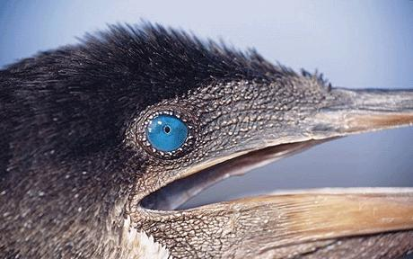
Darwin’s Return
There were other examples too, of animals found on the Galapagos, but nowhere else.

Slide 7
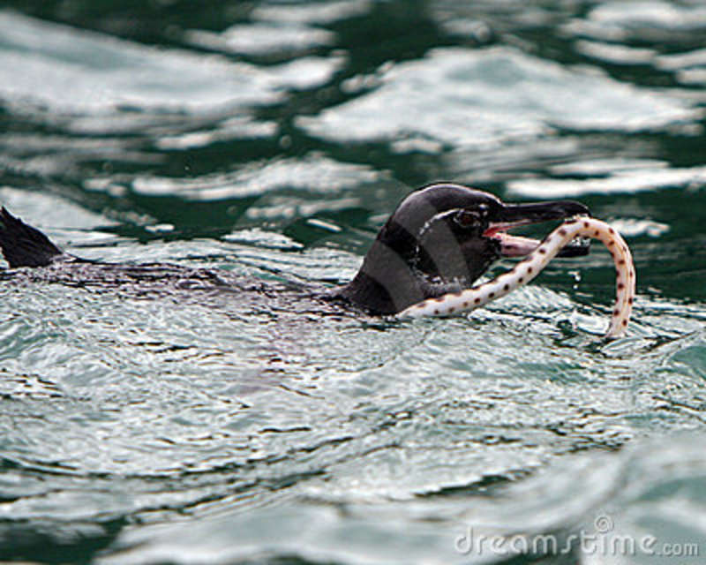
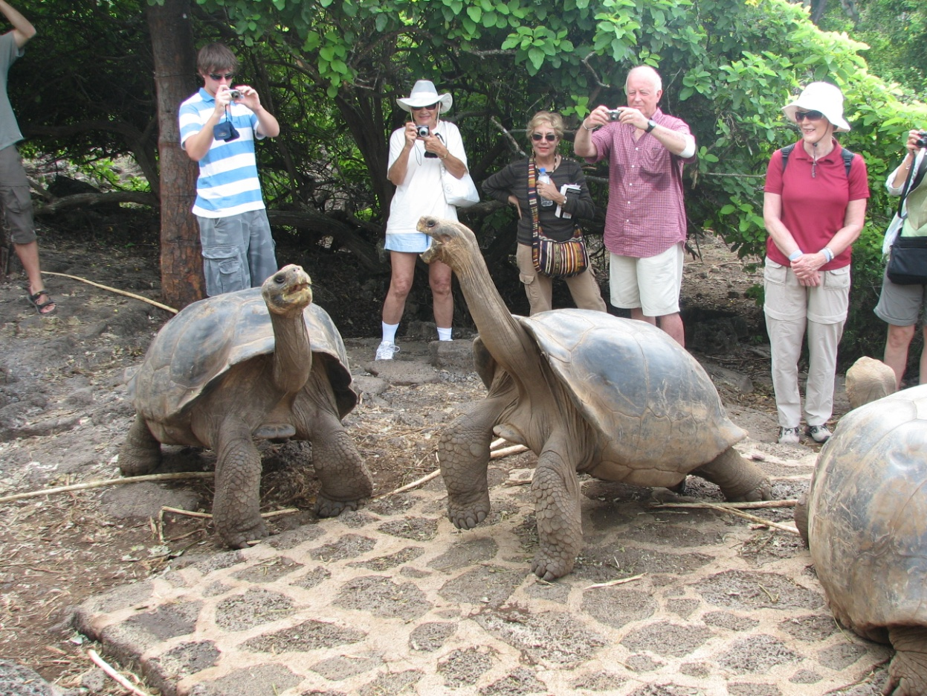
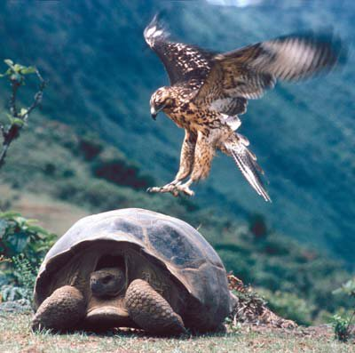
Darwin’s Return
He began to work on making sense of these findings.

Slide 8
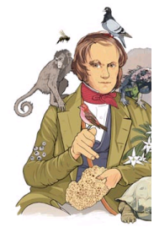
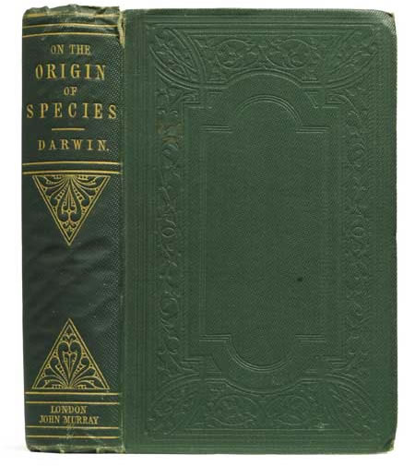
Darwin’s Return
He spent the next 23 years putting together his theory

Slide 9
In 1859 he published On the Origin of Species.

Slide 10
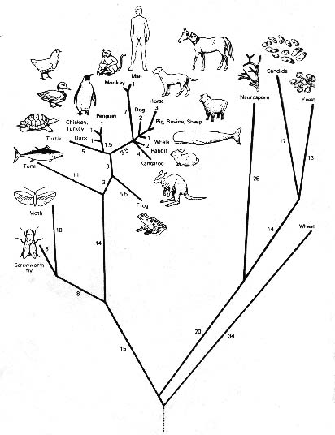
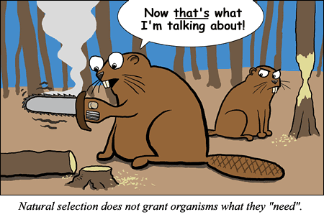
The Big Idea

Slide 11
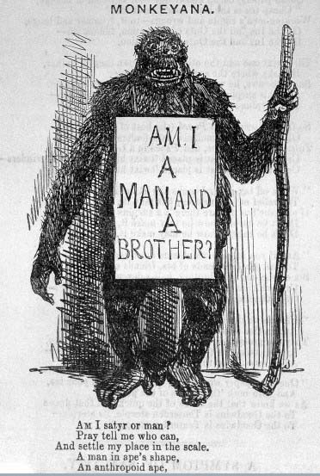
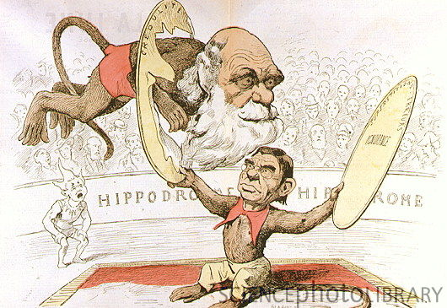
The Big Idea
Response to Darwin’s work was very divided

Slide 12
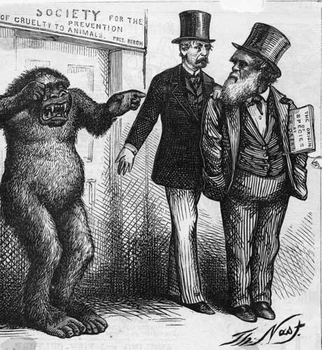
The Big Idea
Some people thought it was brilliant, while others were strongly opposed.

Slide 13
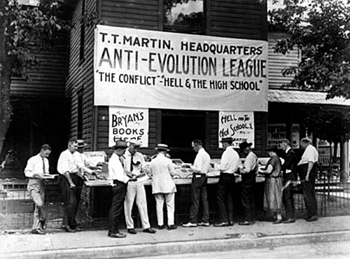
The Big Idea
A situation that is not that different from today

Slide 14
The Big Idea
What exactly is in that book anyway?
Darwin’s principles of Theory of Evolution by Natural Selection can be summed up as follows:

Slide 15
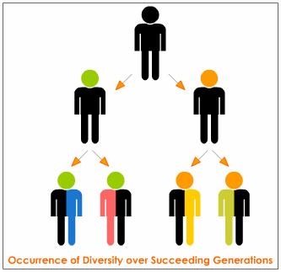
Individual in a population show variations among species, and some of these variations are heritable
Parents pass these variations onto their offsprings
How he got
this idea?

Slide 16
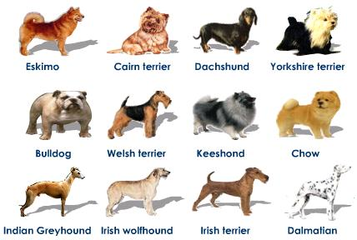
Individual in a population show variations among species, and some of these variations are heritable
Darwin had no idea about DNA (genes) but noticed that animal breeders used heritable variation to produce animals with desirable characteristics
Called Artificial
Selection, nature
provided the variation,
and humans selected
the variations they
found useful.

Slide 17
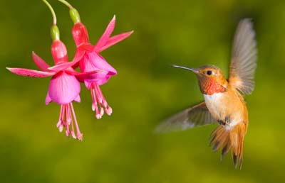
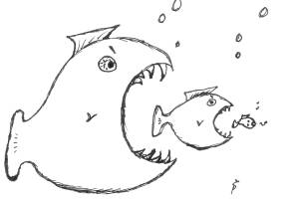
Individual in a population show variations among species, and some of these variations are heritable
Darwin was convinced a process like artificial selection was at work in nature.

Slide 18
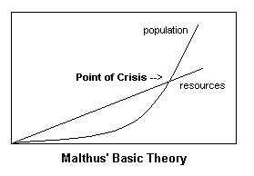
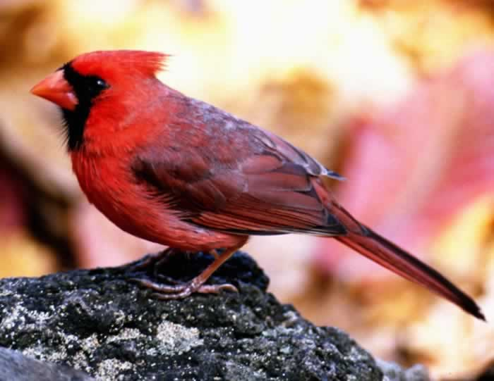
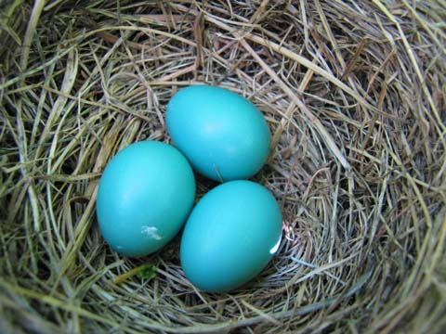
Organisms have more young than can survive on the available resources
Darwin recalled the work of Malthus on population growth
– having too many offspring would result in a competition for resources.
Which ones, Darwin wondered, would be the most likely to survive and reproduce?

Slide 19
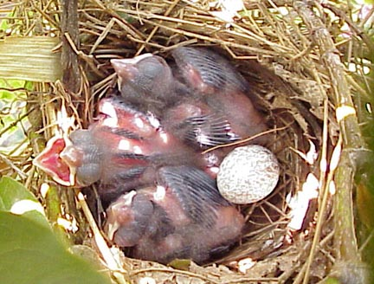
Organisms have more young that can survive on the available resources
Cardinals lay 9 eggs per summer.
If each cardinal lived only a year, and all of the offsprings would survive, there would be over million cardinals in 7 years

Slide 20
Individuals best suited to their environment, due to their variations, survive and reproduce most successfully. (variations that increase reproductive success will be more common in the next generation)
This was Darwin’s Big Idea – that nature will select the characteristics that make
the organism the “most fit”.

Slide 21
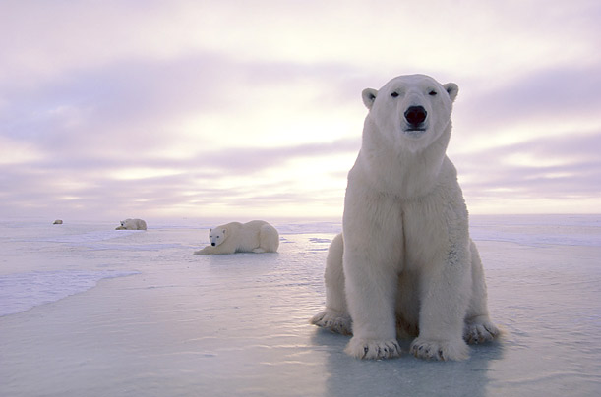
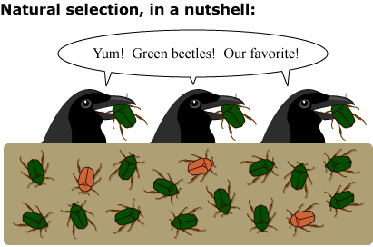
Individuals best suited to their environment, due to their variations, survive and reproduce most successfully. (variations that increase reproductive success will be more common in the next generation)
This was Darwin’s Big Idea – that nature will select the characteristics that make
the organism the “most fit”.
He called this Natural Selection

Slide 22
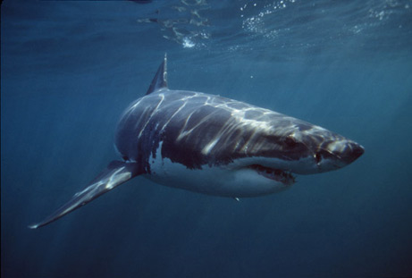
Individuals best suited to their environment, due to their variations, survive and reproduce most successfully. (variations that increase reproductive success will be more common in the next generation)
This was Darwin’s Big Idea – that nature will select the characteristics that make
the organism the “most fit”.
He called this Natural Selection
Only organisms most fit for their environment will reproduce and pass on their genes.

Slide 23
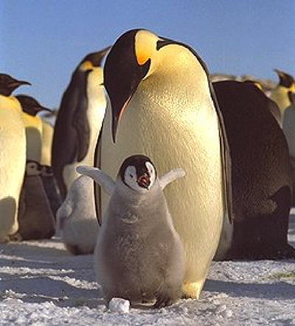
Natural Selection = “Survival of the Fittest”
If you are “FIT,” you LIVE and REPRODUCE.
If you are “NOT AS FIT,” you DO NOT LIVE or you DO NOT REPRODUCE as well.

Slide 24
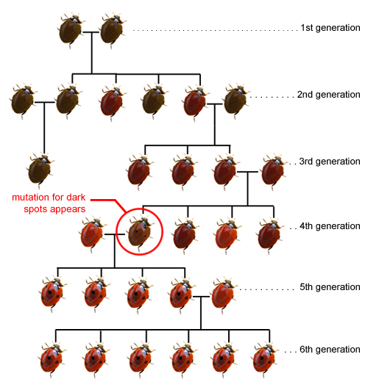
Species alive today descended with modifications from species that lived in the distant past
This process, unites all
organisms on Earth into a
single TREE OF LIFE.

Slide 25
Species alive today descended with modifications from species that lived in the distant past
This process, unites all
organisms on Earth into a
single TREE OF LIFE.

